Slide 1

ONLINE QUIZ MANAGEMENT SYSTEM
Presented by SABA

Slide 2
Objectives of OQMS :
Online quiz management system (OQMS) are computer programs or applications that help create, administer, and manage quizzes, tests, assessments, surveys, or exams.
The main objective of OQMS is to efficiently evaluate the candidate thoroughly through a fully automated system that not only saves lot of time but also gives fast results.
For students they give papers according to their convenience time and there is no need of using extra thing
like pen , papers.
It includes the form of true-false, multiple choice questions etc..

Slide 3
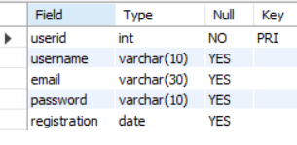
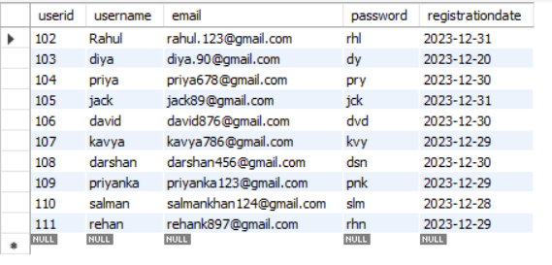
Write SQL statements to create all the tables with the specified columns and foreign key references with populated data.
1 -- Users table –
insert into users values(Userid,“username" , ‘email’ , ’password’, ‘registrationdate’);
create table users(userid int primary key ,username varchar(10),email varchar(30),password varchar(10), registration date);

Slide 4
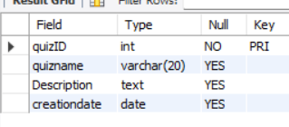
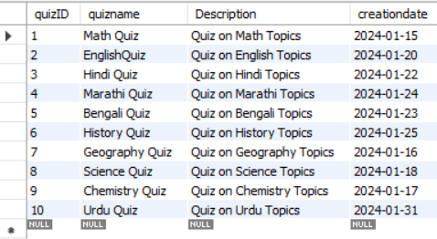
2 – Quizzes Table –
insert into quizzes
values(quizid, ’quizname’ ,’description’, ’creationdate');
create table quizzes(quizID int primary key,
Quizname varchar(10),Descriptiontext,
creationdate date);

Slide 5
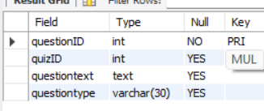
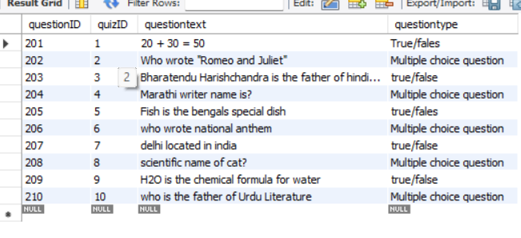
3 – Questions Table –
insert into questions values(questioned , quizid , ’questiontext’ , ’questiontype’ );
create table quizzes(quizID int primary key , quizname varchar(10),Description text , creationdate date);

Slide 6
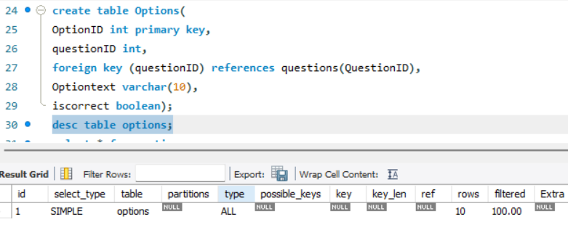
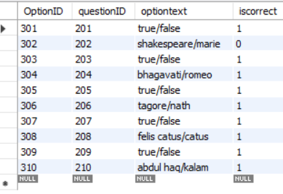
4 – Options Table –
insert into options values(optionid, questionid, ‘optiontext’ , ’ iscorrect ');

Slide 7
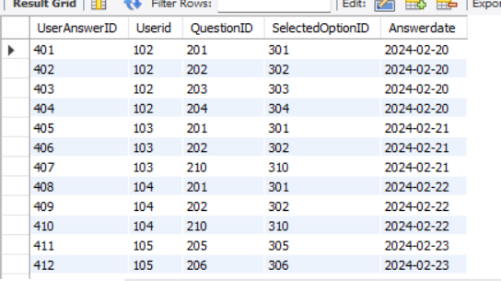
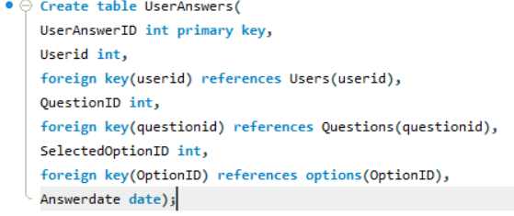
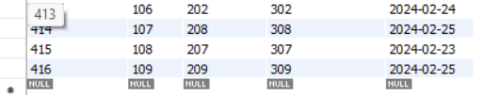
5 – Useranswers Table –
insert into useranswers values(useranswerid , userid , questionid , selectedoptionid, ’ answerdate ');

Slide 8
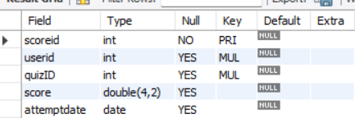
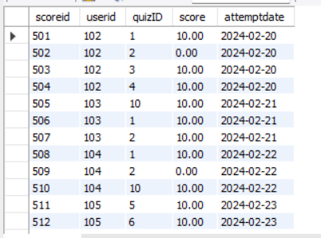

6 – Scores Table –
insert into scores values(scoreid,
Userid ,quizid,
score, ’attemptdate’);
create table scores( scoreid int primary key ,userid int , foreign key (userid) references users (userid) ,quizID int , foreign key (quizID) references Quizzes(QuizID),score double(4,2), attemptdate date);

Slide 9
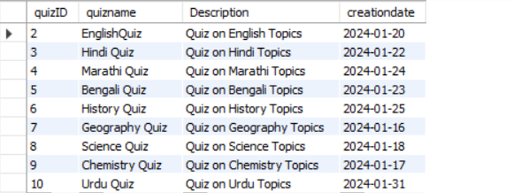
Write a query to select all quizzes created after January 15, 2024, from the Quizzes table.
select * from quizzes where creationdate >'2024-01-15';

Slide 10
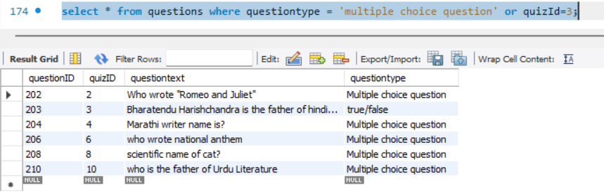
Write a query to select all questions where the QuestionType is 'Multiple Choice’ or the QuizID is 3.
As we can see here quizid 3 is having questiontype true/false but due to where clause(or) it is also reflecting

Slide 11
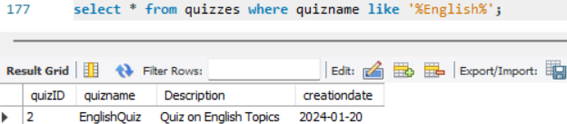
Write a query to select all quizzes where the Quizname contains ‘English'.
Let’s solve this query by using “Like Operator”.

Slide 12
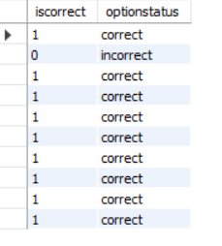
Write a query to select OptionText and add new column OptionStatus from the Options table. If IsCorrect is TRUE, set OptionStatus to 'Correct', otherwise 'Incorrect'.
select iscorrect, case when iscorrect = 1 then 'correct' else 'incorrect' end as optionstatus from options;

Slide 13
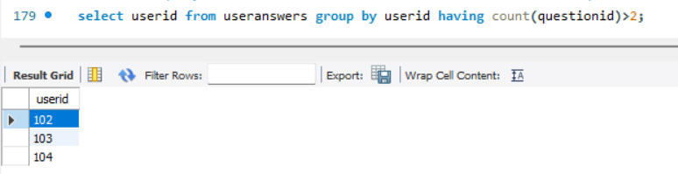
Write a query to find all users who have answered more than 2 questions. Use a subquery in the WHERE clause to find these UserIDs.
Out of 10 users only 3 users has opted for more than 2 Question

Slide 14
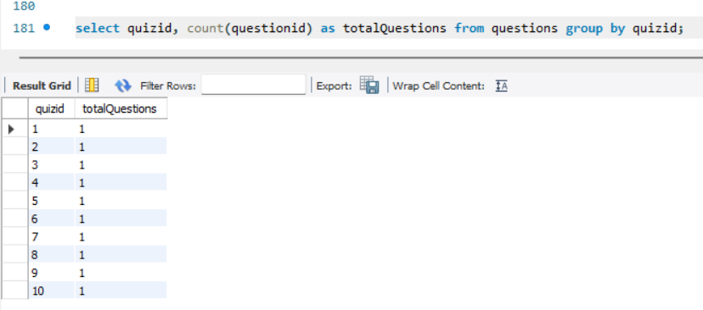
Write a query to get the total number of questions for each quiz. Group the results by QuizID.
As we have created one question for each Quiz, hence the total Questions count is 1.

Slide 15
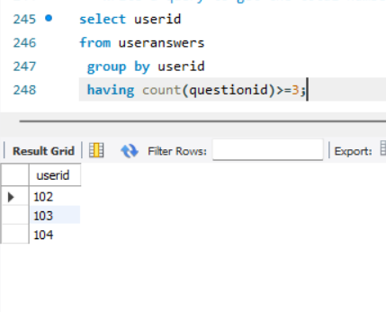
Write a query to get the total number of quizzes attempted by each user, but only include users who have attempted 3 and more than 3 quizzes. Use the HAVING clause

Slide 16
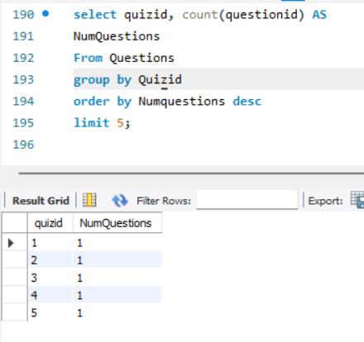
Write a query to select the top 5 quizzes with the highest number of questions.

Slide 17
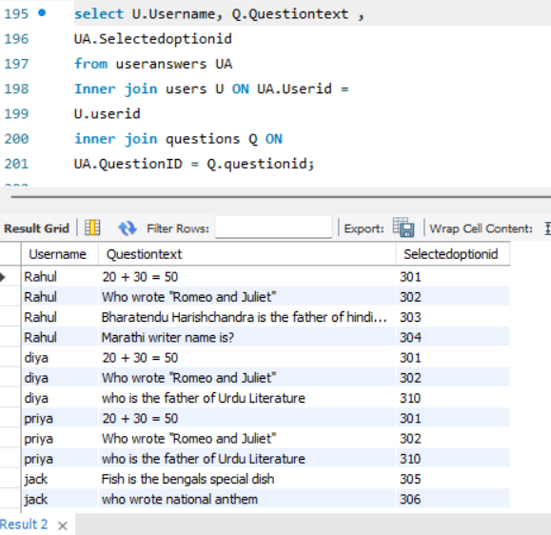
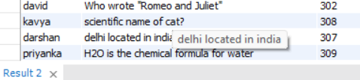
Write a query to join UserAnswers with Questions to get a list of all user answers including Username, QuestionText, and SelectedOptionID.

Slide 18
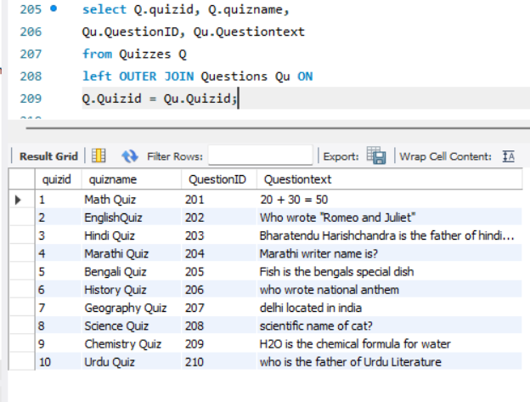
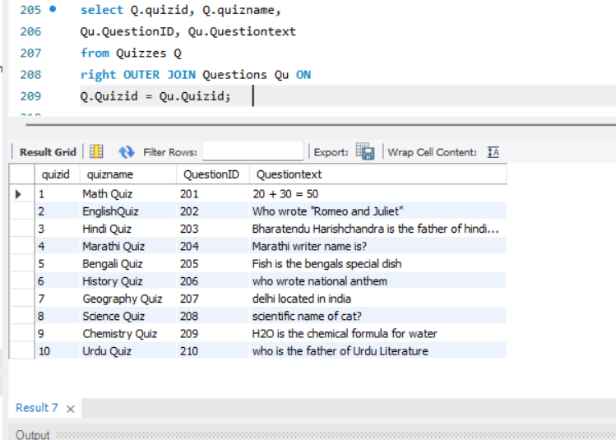
Write a query to get a list of all quizzes and any associated questions. Include quizzes that might not have any questions.
From table quizzes and Questions every quizname has questions

Slide 19
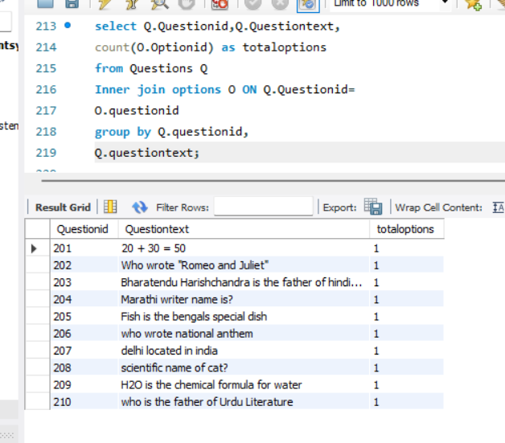
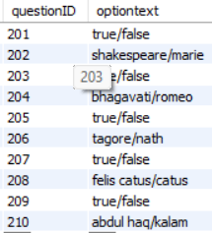
Write a query to get the total number of options for each question. Use an INNER JOIN between Questions and Options, and group by QuestionID.
Option for each questiontext would be 1 as we have combinly mentioned in optiontext table.

Slide 20
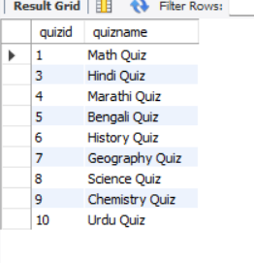
Write a query to find all quizzes where the average score for all users is 10. Use a subquery in the WHERE clause to find these QuizIDs.
select Q.quizid, Q.quizname from Quizzes Q
where Q.quizid in (
select s.quizid
from Quizzes Q
join scores S on Q.quizid = S.quizid
group by S.quizid
having AVG(S.score)=10);
users has failed to answer correctly for quizid=2

Slide 21
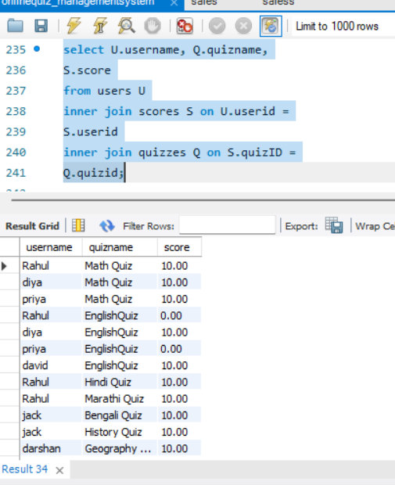
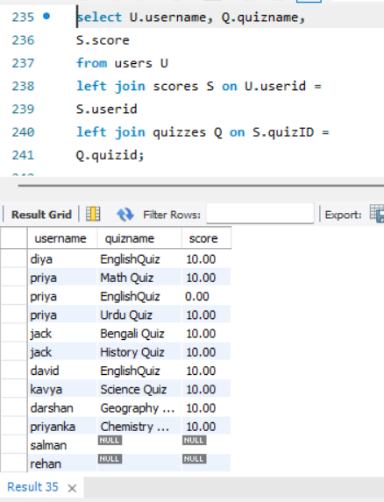

Write a query to list Username, QuizName, and Score for all users who have completed a quiz. Use INNER JOIN and LEFT JOIN as necessary to get all required details.
8 users has completed their quiz out of 10 , by using inner join.
Lets find those name who didn’t completed their quizzes by using Left join?

Slide 22
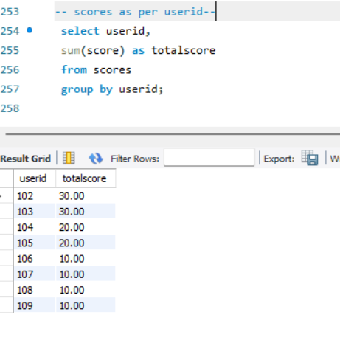
Users totalscore;
From users table userid 110 & 111 has not opted for quiz & the winner for this quiz is user 102 & 103 (at first place).

Slide 23
Insights from SQL:
Firstly we have created multiple tables by using create query with primary and foreign key,
we also have added new column in a table by using alter table and add query.
Used Where clause (and/or), like operator, Case statement query, subquery, group by clause, having clause ,
Inner join, outer join, join with aggregation, subquery with join , last but not the least we applied Advanced join query to do the data manipulation and to get prompt results.

Slide 24
Thank you

